Slide 1
Unlocking the Future of Friendship Force
Increasing Club Possibilities
via 501(c)(3) Status
Molly Hunter
Friendship Force of Greater Cincinnati

Slide 2
Unlocking the Future of Friendship Force
Super-Regional Conference
April 20-21, 2018

Slide 3
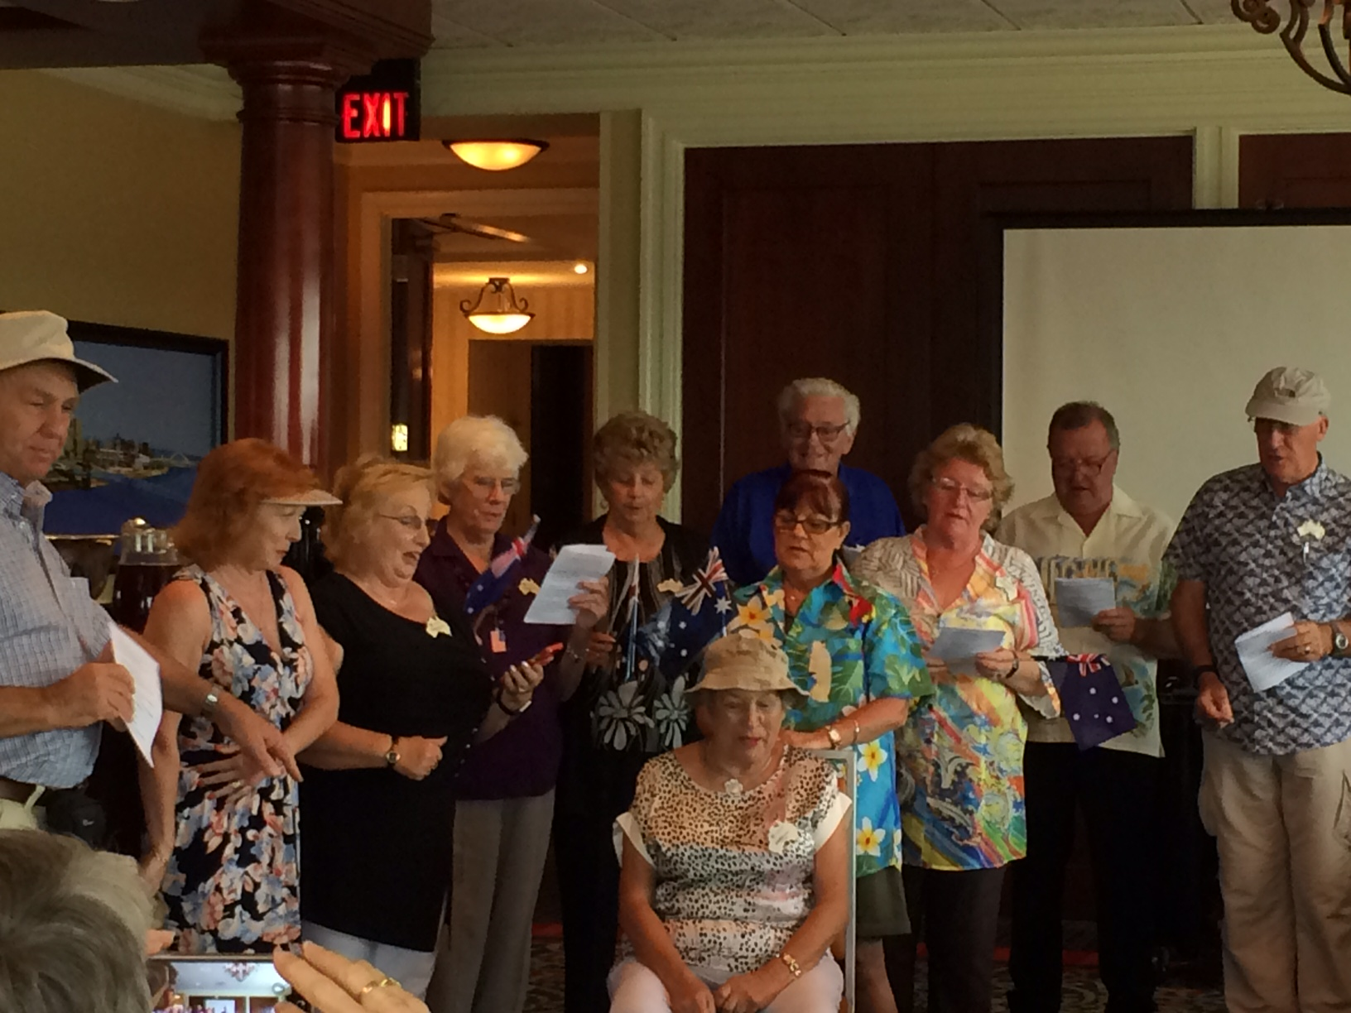

Slide 4
Increasing Club Possibilities via 501(c)(3) Status
INTRODUCTIONS
WHAT IS 501(c)(3) STATUS?
ADVANTAGES
WHAT’S THE CATCH?

Slide 5
Increasing Club Possibilities via 501(c)(3) Status
INTRODUCTIONS
NAME, FF CLUB, TITLE
ARE YOU ALREADY A 501(c)(3)?

Slide 6
Increasing Club Possibilities via 501(c)(3) Status
WHAT IS 501(c)(3) STATUS?
TAX EXEMPT NON-PROFIT
STATE SALES (other?) TAXES
FED INCOME TAX
Notes:
CHARITABLE, ETC

Slide 7
Increasing Club Possibilities via 501(c)(3) Status
WHAT IS A 501(c)(3)?
26 U.S. Code § 501 - Exemption from tax on corporations, certain trusts, etc.
(c) List of exempt organizations
(3) Corporations, etc.…operated exclusively for religious, charitable, scientific, … literary, or educational purposes, … no part of the net earnings of which inures to the benefit of any private shareholder or individual, no substantial part of the activities of which is … attempting, to influence legislation, and which does not participate in, or intervene in any political campaign….

Slide 8
Increasing Club Possibilities via 501(c)(3) Status
A 501(c)(3) ORGANIZATION
TAX EXEMPT, NON-PROFIT
NO LOBBYING
FF IS “EDUCATIONAL”
Notes:
CHARITABLE, ETC

Slide 9
Increasing Club Possibilities via 501(c)(3) Status
ADVANTAGES/Strategic Planning
TAX EXEMPT
DONATIONS TAX DEDUCTIBLE
FOUNDATION FUNDING
Notes:
STATE SALES TAXES, FEDERAL INCOME TAXES, VARIOUS OTHER STATE TAXES…WE DON’T OWN PROPERTY RE PROPERTY TAXES…

Slide 10
Increasing Club Possibilities via 501(c)(3) Status
WHAT’S THE CATCH?

Slide 11
Increasing Club Possibilities via 501(c)(3) Status
THE CATCH IS YOU MUST:
INCORPORATE (FEE)
APPLY TO THE IRS (FEE)
FILE BASIC INFO YEARLY

Slide 12
Increasing Club Possibilities via 501(c)(3) Status
WHAT’S THE CATCH?
INCORPORATE
Articles of Incorporation
With Necessary Purposes
Sign off by officer
Filing fee $50 to $150

Slide 13
Increasing Club Possibilities via 501(c)(3) Status
WHAT’S THE CATCH?
APPLY TO THE IRS
1023-EZ (SS-4 for EIN)
Attach Articles of Incorporation
Sign off by officer
Fee $400 !

Slide 14
Increasing Club Possibilities via 501(c)(3) Status
WHAT’S THE CATCH?
ANNUAL FILINGS
IRS e-POSTCARD if receipts are less than $50,000
STATE
Notes:
IF UNDER $50,000 REVENUES

Slide 15
Increasing Club Possibilities via 501(c)(3) Status
INTRODUCTIONS
WHAT IS A 501(c)(3)?
ADVANTAGES
WHAT’S THE CATCH?

Slide 16
Increasing Club Possibilities via 501(c)(3) Status
LET OTHERS IN YOUR CLUB KNOW:
501(c)(3) ADVANTAGES
STEPS AND APPLICATION FEES
NEED SOMEONE TO DO IT – WHO?
Notes:
YOUR MISSION IF YOU CHOOSE TO ACCEPT IT IS:

Slide 17
Increasing Club Possibilities via 501(c)(3) Status
Super-Regional Conference, April 2018

