Slide 1
Leadership Development

Slide 2
Lets move from just selecting leaders to developing leaders with the right interests, skills and knowledge to be successful
Lets spread out the leadership responsibility in the club because everyone can contribute in their own way and capacity

Slide 3
Get To Know Your Members
Understand why they joined and their expectations
Make sure they understand that we are not a travel club
Identify their interests and abilities
Respect leadership capabilities from outside of Friendship Force
Get them engaged in the club as soon as they join
Initiate new members with idea that the club works by everyone contributing in some way

Slide 4
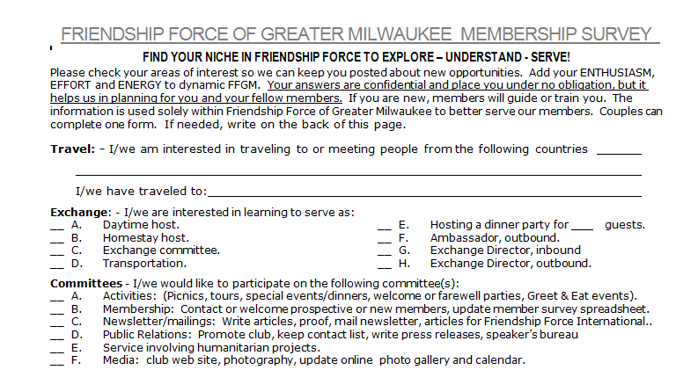
Member Survey

Slide 5
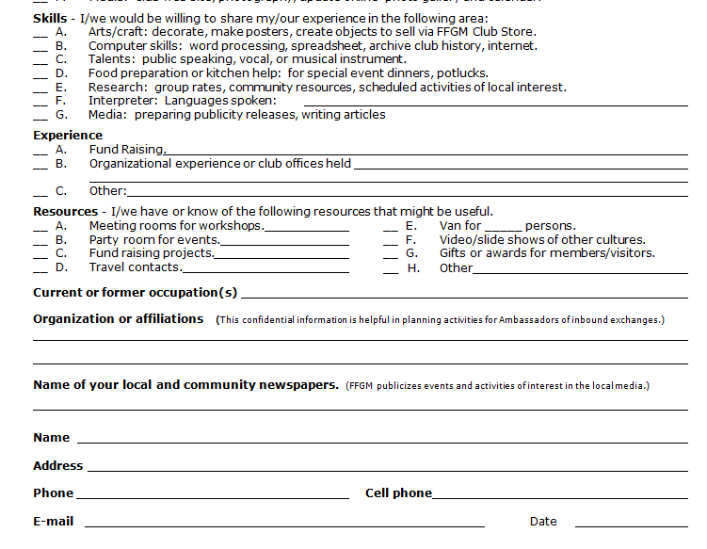
Member Survey

Slide 6
Developing Leaders
Predict success by matching the person’s interests and skills with the responsibilities of the position
Mentor and train
Realize that not everyone has the skills or desire to take on the top leadership position
Clearly define the responsibilities of the position

Slide 7
Board Manual
PRESIDENT
The club president administers the most vital unit of FFI, the local club. That individual is essential to the success of the organization’s worldwide network. Although the position entails work of a general business nature, it should also focus on the larger issues of FFI. While leading the club, the president must communicate and instill enthusiasm for the goals, activities and policies of FFI as set by the International Board of Directors.
The president is elected by the membership for a term of two years with the term beginning in January of the odd numbered years. He/She reports to the club Board as well as to Friendship Force International.
Duties:
1. Act as the official spokesperson for the club and as liaison with other FF organizations.
2. Preside at all Board meetings and business meetings of the club.
3. Appoint the chairpersons of all standing committees, subject to confirmation by the Board.
4. Sign or be an alternate signatory for the withdrawal of club funds.
5. Prepare a summary year’s end report for the annual meeting.
6. Appoint, with board confirmation, an annual financial auditing committee.
7. Confirm that a club membership report with fee is sent to FFI in a timely fashion.
8. Confirm that annual Incorporation renewal and tax filing is completed and sent.
9. Attend and participate in the World conference and Midwest regional conference or confirm a substitute in the president’s stead using the following criteria:
Experience in club matters
  Policies
  Finances
  Activities
  Journeys
AC or HC Experience
Incoming
Outgoing
Hosting experience
Ambassadorial experience
Length of membership
If multiple representatives are being considered, the Board decision should be made by ballot.
10. Maintain effective relations with FFI and the Midwest Regional Representative and communicate pertinent and timely information to the Board of Directors.
11. Annually forward updated contact list of Midwest regional clubs to Communication Committee Chair.
12. It is recommended, if possible, that the President or Vice-President attend standing committee meetings

Slide 8
Plan for Leadership
Board structure
Board manual and club bylaws
Succession planning
Continuity during leadership changes
Possibly develop a Leadership Development Committee

Slide 9
Successful Leaders
Run efficient meetings
  Understand the purpose of the meeting
  Create agenda and time limit. Take notes.
  Take control of the meeting. Keep on topic.
Are decisive and fair
Are a facilitator instead of a dictator
Effectively use their personal leadership skills

Slide 10
Personal Leadership Skills

Slide 11
Working with Volunteers
Friendship Force Volunteers aren’t paid so they have different motivations
Match the job to the volunteer
Clearly define expectations
Provide appropriate training and information
Follow-up
Thank and recognize volunteer

Slide 12
Delegation
Communicate the project
Communicate responsibilities
Make yourself available for questions and guidance
Track progress and give feedback
Allow for creativity and variations in work style
Provide credit and appreciation

Slide 13
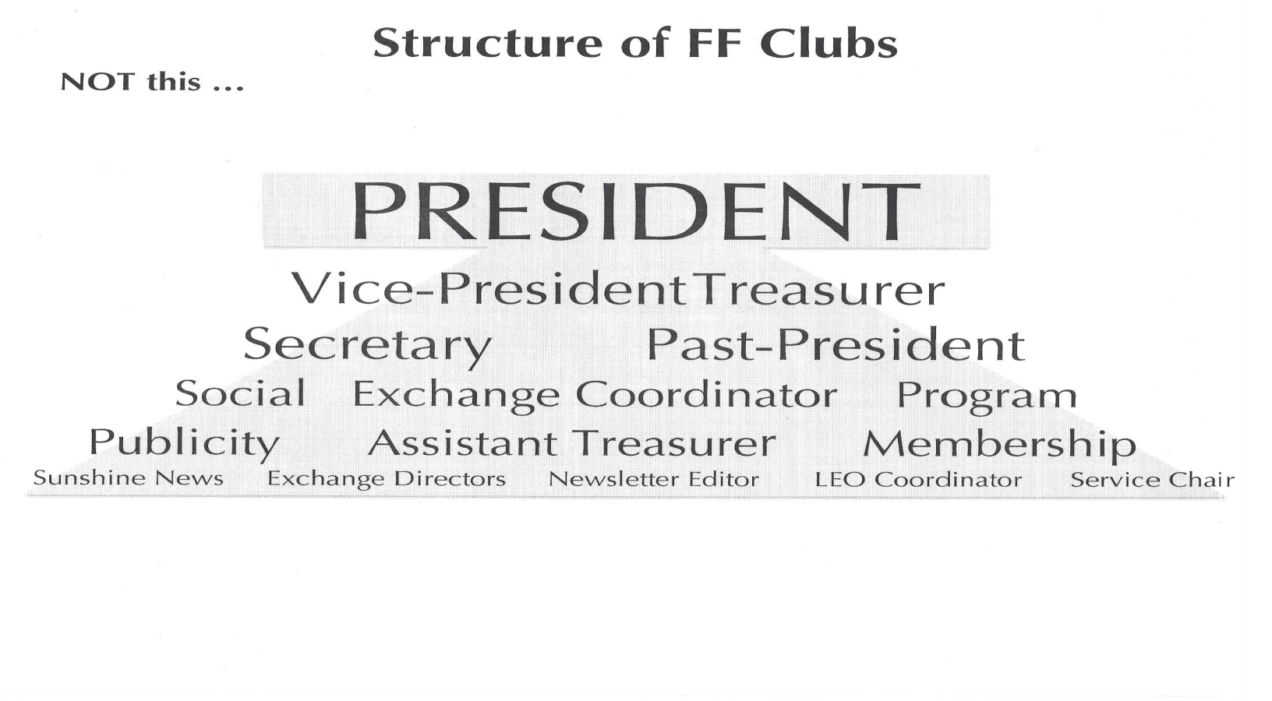
Don’t Use This Model….

Slide 14
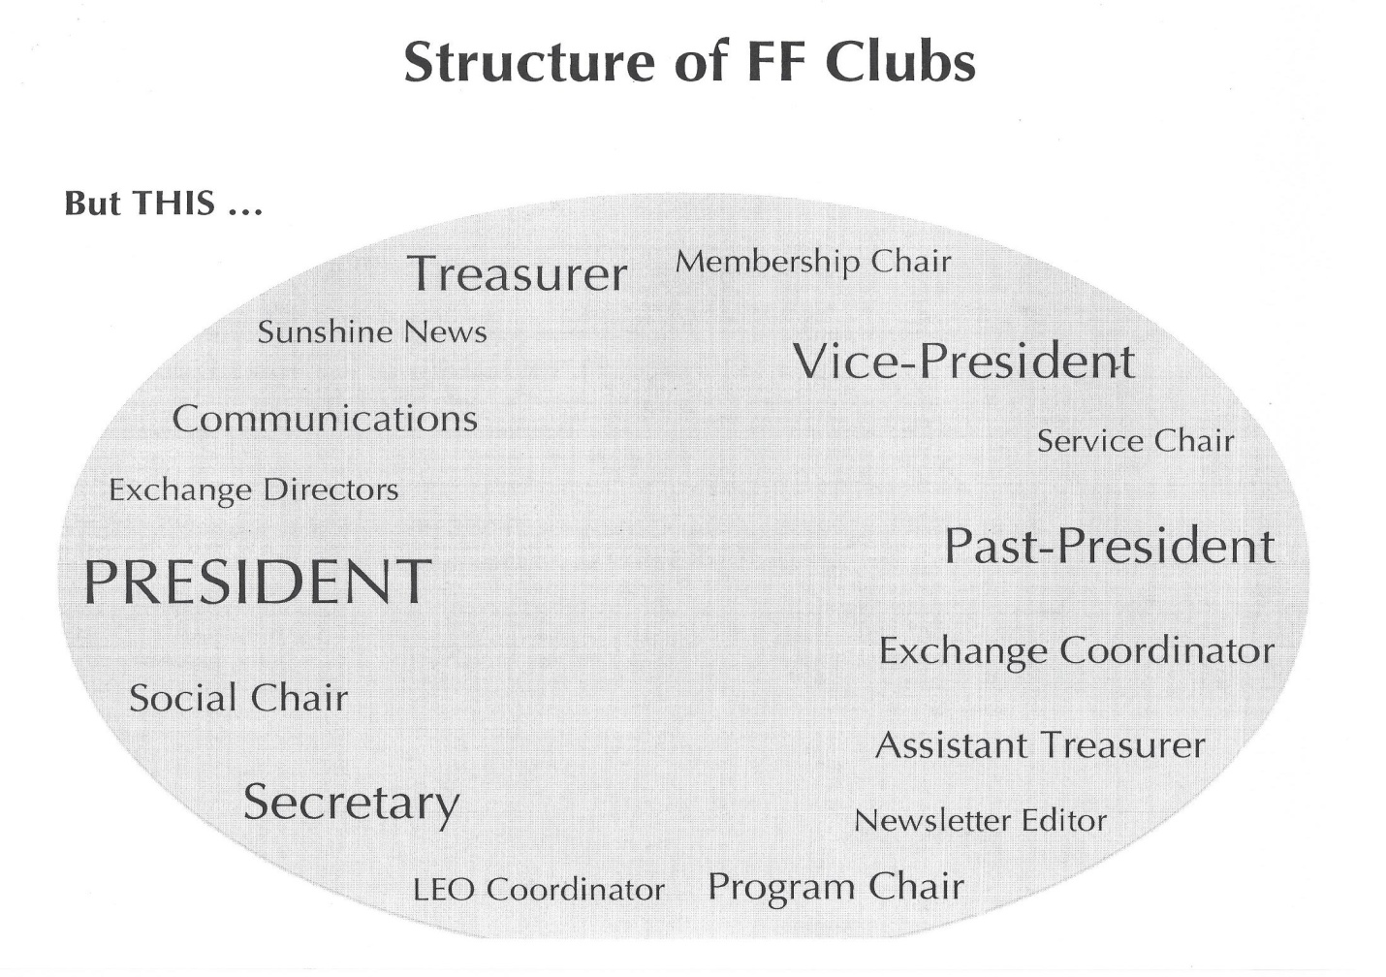
Use this Model…

Slide 15
Communication
Consider the audience
Consider the mode of communication
How do you personally best communicate?
Good communicators are good listeners
Know what and why you are communicating
Be precise and keep your message simple
Consider the tone of the message especially over e-mail and social media

Slide 16
Inspiration
Leadership Approaches:
Visionary – Clear picture of the future which is communicated to the group
Enhancing – Create one-on-on relationships among team and a great listener
Driver – Focused on the goal
Principled – Powerful role model
Enthusiast – Exude passion and energy about the organization
Expert – Provide strong technical direction

