Slide 1
Mentoring Leaders Pat Meyer, presenter
“The function of leadership is to produce
more leaders, not more followers.”
Ralph Nader
Friendship Force Midwest/Great Lakes
Regional Conference
Quad Cities, Illinois/Iowa
April 28-May 1, 2016

Slide 2
Whom will we target?
How will our campaign be accomplished? Dinners? Advertising? Outreach to other groups? Or?
A Friendship Force Campaign for New Club Members
When is the best time to implement?
Where? Restaurant? Member homes? Or?
What’s our goal?
Why we need new members. Getting club buy-in.

Slide 3
How did you arrive at your responses?
Did everyone discuss before each of you wrote?
Did the group consider multiple ideas?
Did everyone participate?
Did you listen to each other?
Did you revise your ideas based on discussion?

Slide 4
What does collaborating on a membership drive have to do with Mentoring Leaders?
Everything!

Slide 5
Midwest Field Rep’s Concerns
Presidents saying, “I can’t wait for this to be over!”
Some clubs with no Vice-presidents; no clear leadership succession
Finding new leaders like pulling teeth!
President the ‘heavy lifter’ for the club
New leaders installed without mentoring or background/experience
Leadership pool dwindling

Slide 6
Does your club look like this?
PRESIDENT
Vice-President Treasurer
Secretary Past-President
Social Exchange Coordinator Program
Publicity Assistant Treasurer Membership
Sunshine News Exchange Directors Newsletter Editor LEO Coordinator Service Chair

Slide 7
Or this?
Treasurer
Membership Chair
Sunshine News
Vice-President
Communications
Service Chair
Exchange Directors
Past-President
PRESIDENT
Exchange Coordinator
Social Chair
Assistant Treasurer
Secretary
Newsletter Editor
LEO Coordinator
Program Chair

Slide 9
The function of leadership is to produce more leaders, not more followers. — Ralph Nader

Slide 11
How do clubs develop a TEAM of leaders?
Retreat!

Slide 12
Requirements for a Successful Retreat
Location — get away from the routine
Good working conditions
Without interruption
Comfortable space for a group
Opportunities for Play!
Simplified food (cater or make ahead)
A clear agenda and goals

Slide 13
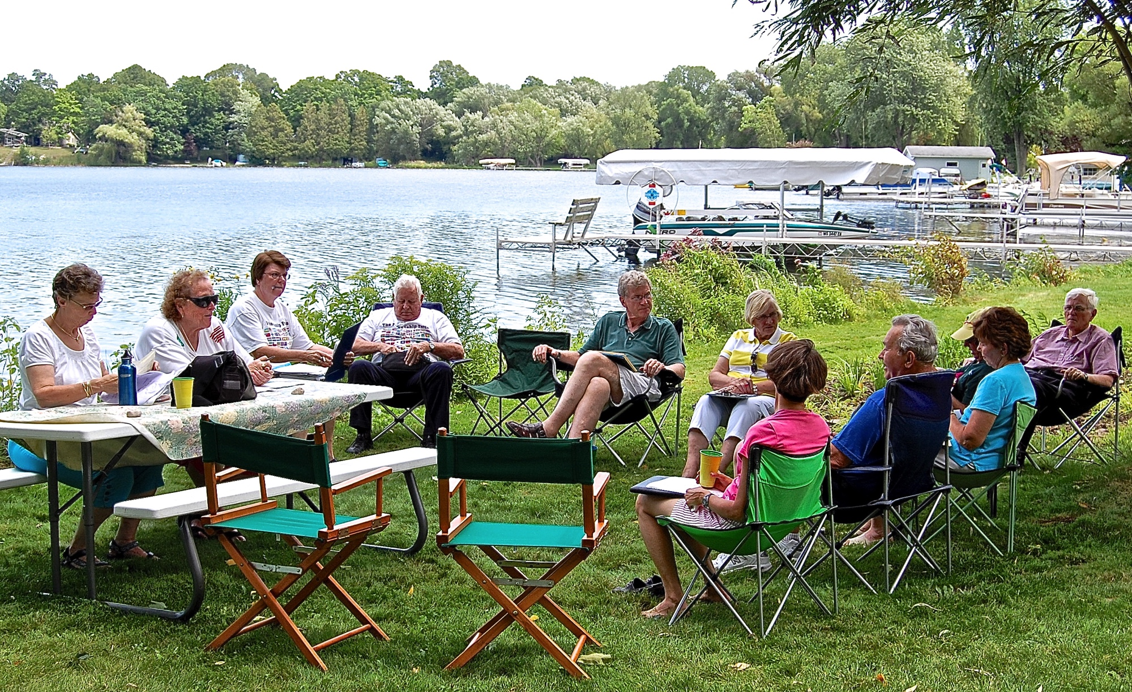
Northern Illinois Board Retreat
at a member’s Wisconsin cottage, 2009

Slide 14
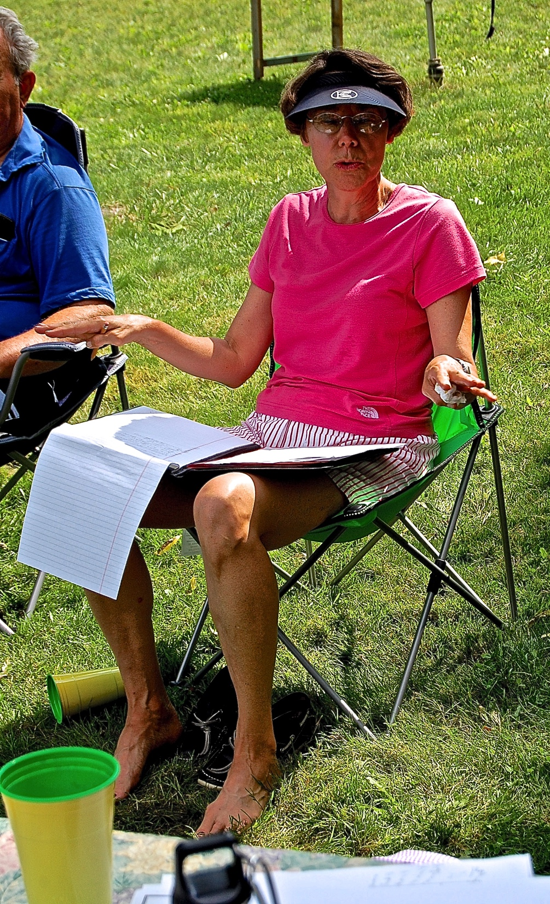
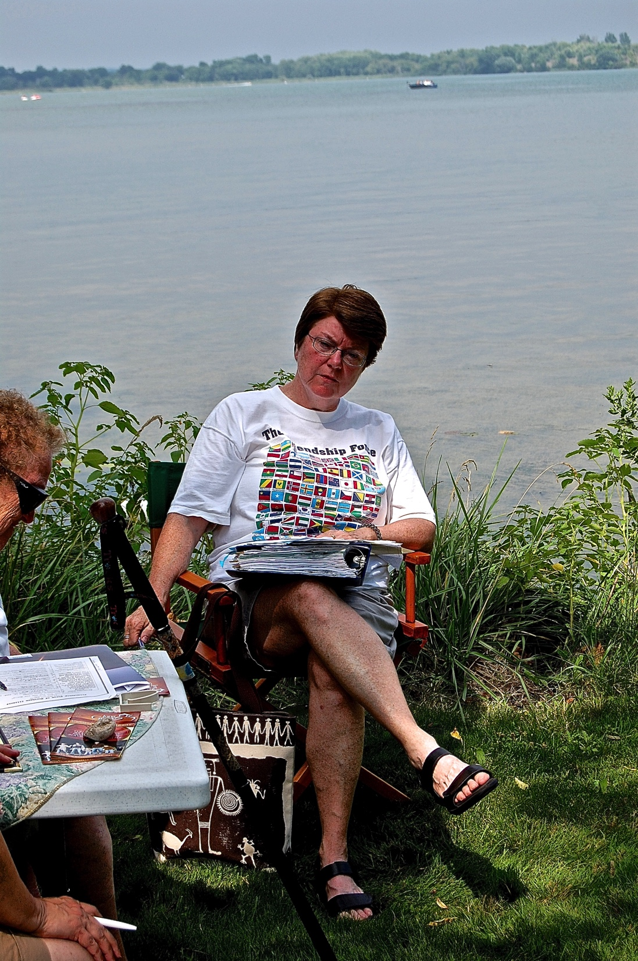
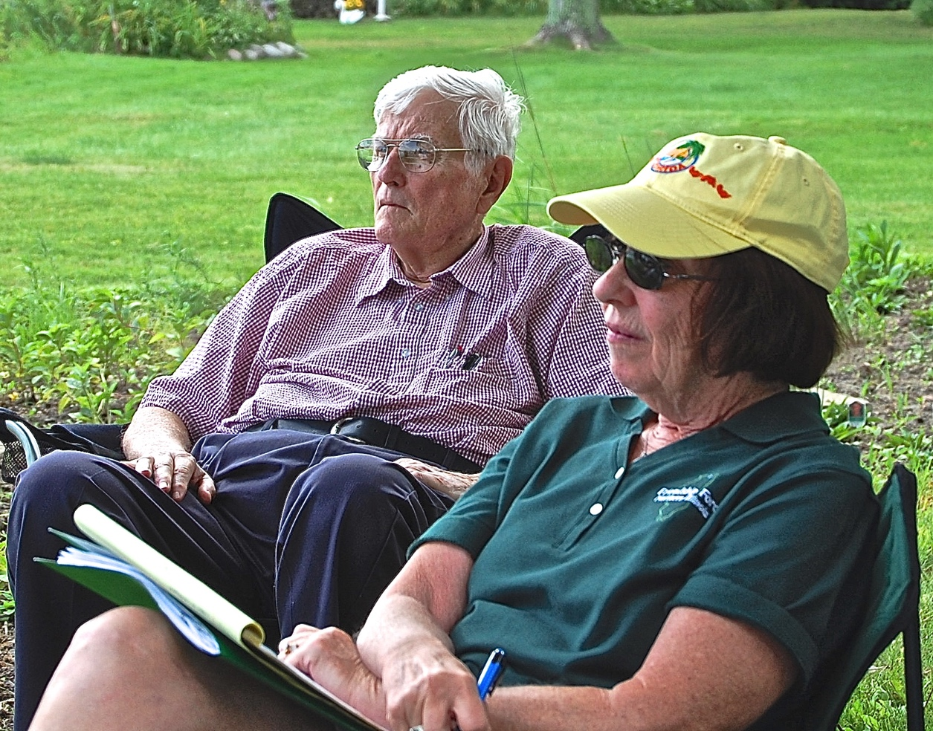
We Worked

Slide 15
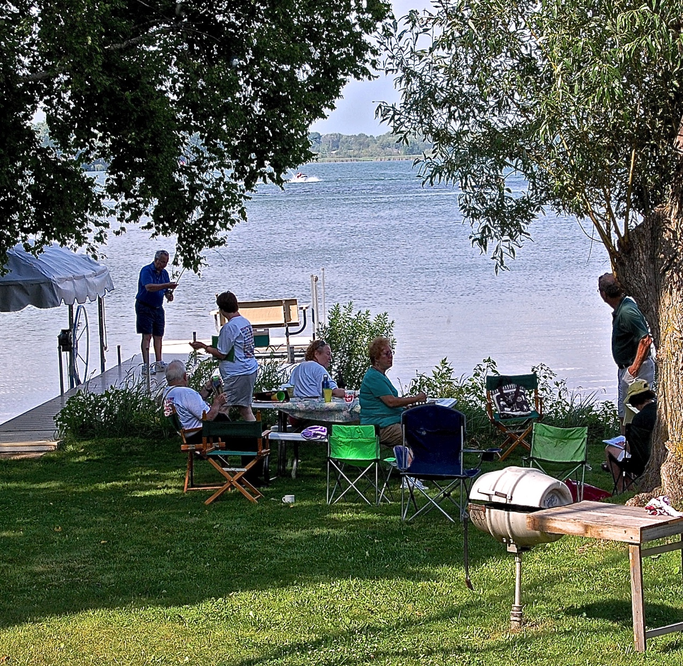
We Played

Slide 16
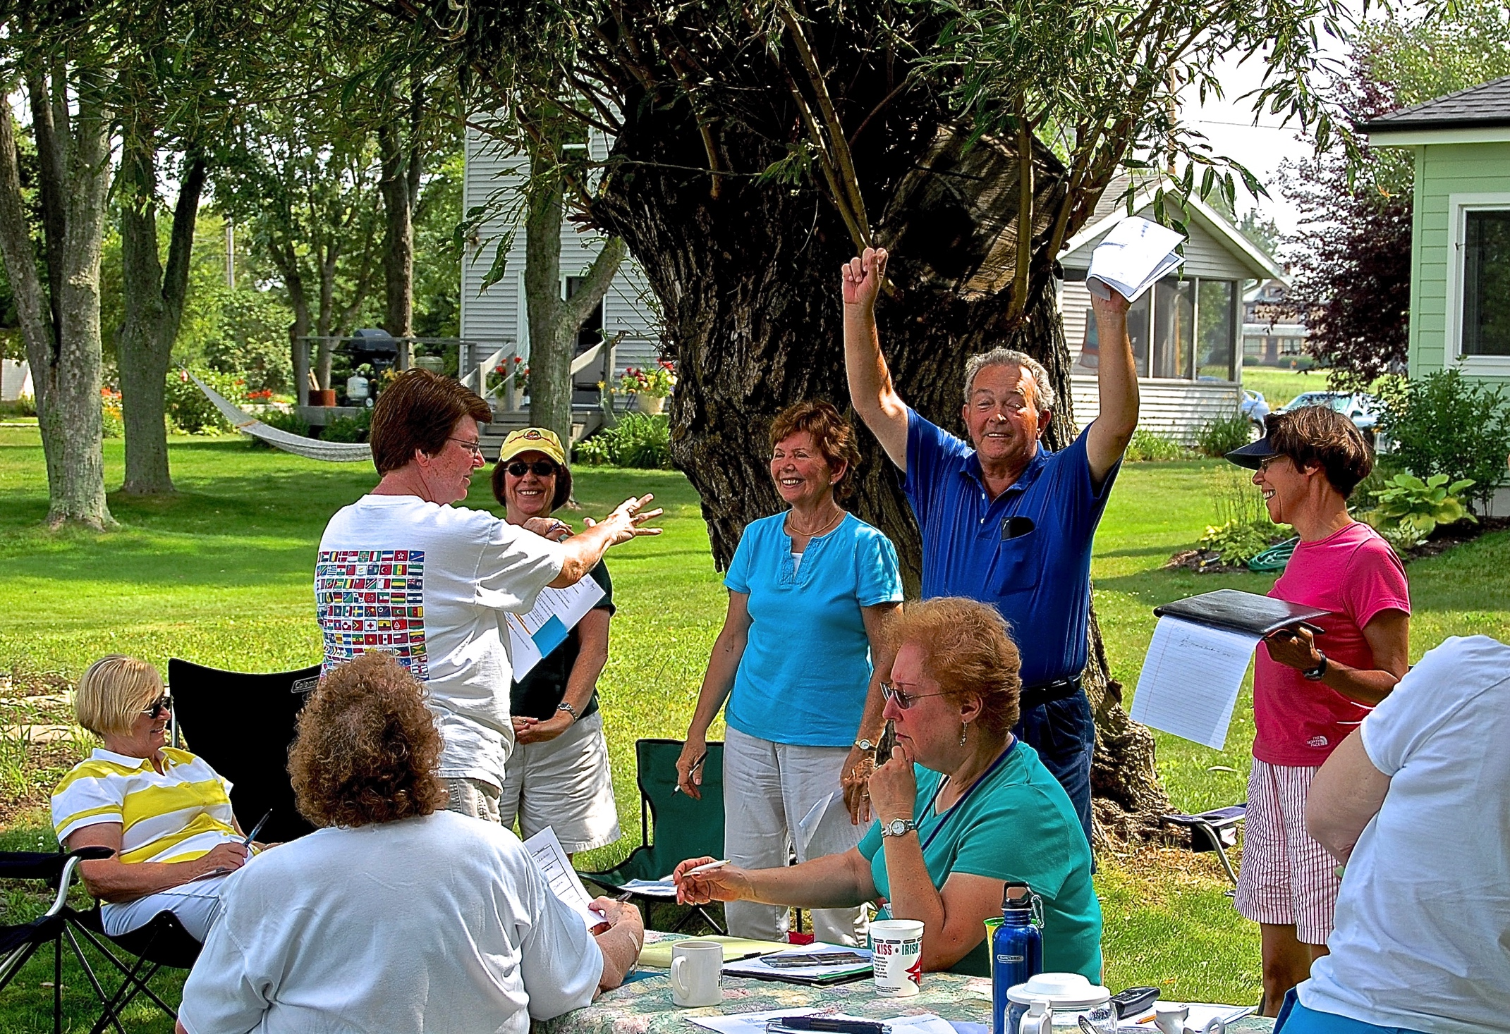
And we met our goals!

Slide 17
Essential: ALL Board Members attend.
Also: Invite new, younger members
not yet on the Board.

Slide 18
Include team building activities
before beginning club business.
For example:

Slide 19
In teams
draw a coat of arms for your club
Club
Highlights
Club
Values
Club Accomplishments
Motto

Slide 20
Or create a
Memory Board
Outbound Exchanges
Inbound Exchanges

Slide 21
Numerous Team Building Activities can be found on the internet.

Slide 22
President’s Vision
(an example)
Friendship Force will be known in our community as an organization that reaches out to the local ‘international community,’ seeking to make them feel welcome while helping them to understand the culture they have joined.

Slide 23
Participants
Discuss and Refine
this Vision as needed.
Participation = Teamwork = Buy-in

Slide 24
Leadership TEAM
develops club GOALS
out of the vision.
Participation = Teamwork = Buy-in

Slide 25
Club Goals
(an example from FFNI, 2009)
Increase membership by at least 10%;
Stay connected to current club members;
Become involved in a service project;
Know, understand, and embrace cultures and individuals different from ourselves; and
Be an active force for peace and friendship in our community and the world.

Slide 26
Leadership TEAM
develops and commits to means of achieving goals.
Participation = Teamwork = Buy-in

Slide 27
Leaders’ Commitment to Goals
(an example from FFNI, 2009)
How YOU will help us meet our goals:
Who are three perspective members we should contact or you will bring to a meeting?
What more can we do to insure we connect with all club members throughout our large geographic area?
What are ideas for active community involvement to further Friendship Force values?
What cultures should we explore in our programs?
What have we not done or considered that would further the cause of peace?

Slide 28
The President does not act alone!

Slide 29
The President’s Role:

Slide 30
Encourage & Support the Leadership Team
as they work with the whole membership to fulfill the goals.

Slide 31
Monitor Progress
On the agenda of every Board Meeting
Done by whole Leadership Team
Adjust Goals as needed

Slide 32
Communication
Responsibility of Leadership Team, not just President
Keep Goals in front of the members via
— Newsletters
— General meetings
— Occasional emails to the members
— Texts, tweets, etc.

Slide 33
Additional Ideas on Meeting Goals
Consult each other
Email or call other regional presidents
Email or call your FF Regional Rep
Email or call Staff at FFI in Atlanta!
Use the forms and other resources available on the FFI Website

Slide 34
Other Considerations
Discover & use the talents of your membership
Younger members will be accustomed to collaborating in teams
Develop & implement a working plan to engage new members

Slide 35
Collaboration Mentors New Leaders as they
Set goals together
Create strategies to fulfill those goals together
Implement those strategies together
Evaluate and revise goals together
Learn collaborative leadership together

Slide 36
Remember Ralph Nader:
The function of leadership is to produce more leaders, not more followers.

Slide 37
FF Clubs that Foster New Leaders

Slide 38
Look like THIS
Treasurer
Membership Chair
Sunshine News
Vice-President
Communications
Service Chair
Exchange Directors
Past-President
PRESIDENT
Exchange Coordinator
Social Chair
Assistant Treasurer
Secretary
Newsletter Editor
LEO Coordinator
Program Chair

Slide 39
Collaborating in Teams = Mentoring Leaders!

Slide 40
Move into the Future: COLLABORATE

Slide 41
