Slide 1
Connecting Friendship Force to Groups of People

Slide 2
For years we have relied on one-on-one networking to promote Friendship Force. However, if clubs take the extra effort to learn how to connect with groups of people, they may be able grow faster and become more diverse.

Slide 3
Why Connect with Groups of People?
Tap into a larger audience for potential members
Recruit new diverse FF members
Take the FF mission into the local community
Develop connections, relationships and exposure in the local community
Provide learning experiences for your club members
Provide opportunities for new types of activities for incoming ambassadors

Slide 4
Do What Works for Your Club
Many of the ideas sound simple and obvious but some clubs aren’t making the effort.
Not every idea will work in every community. Choose the ideas which will work best for your club environment.
We need to share success stories to learn from each other.
If you tried it in the past and it didn’t work, that doesn’t mean it can’t work now.

Slide 5
Large Number of Potential Members
Some FF people have adopted the term “Fishing with a Net” to describe recruiting clusters of members and exchange participants from existing networks of like-minded people.

Slide 6
Meetup and Other Internet Groups
Meetup is a web tool that helps people find others who share the same interest
Meetup is easy to learn and easy to use
There are currently 2910 Meetup travel clubs in 911 cities and 53 countries for a total of 1.2 million members

Slide 7
Example from Western Michigan
Added 7 new members in the last two years through Meetup
Exposed almost 100 additional people to FF through the Meetup group
Those who joined FF have hosted, traveled on 8 exchanges and two are serving as at-large members on the board

Slide 8
Survey Your Members to Find Out Their Connections in the Community
Clubs
Volunteer/service organizations
Professional organizations
Like-minded organizations
Religious groups
Ethnic groups
Universities

Slide 9
Special Interest Groups/Clubs
Biking, hiking, photography, birding
Gardening, nature, environmentally-minded
The arts, food
Language learners
Women’s organizations
If a club designs a program that includes an activity with a special interest, then they can ask that special interest group to help out or participate

Slide 10
Volunteer and Service Organizations
Rotary
Habitat for Humanity
Discover Corps
Returned Peace Corps volunteers
Adding a service activity into an exchange and connecting with a local service organization can expose local volunteers to FF

Slide 11
Professional Groups
Retired teacher association
Retired nurses

Slide 12
Like-minded Organizations
SERVAS
B&B organizations (Evergreen)
Travel organizations
World Affairs Council

Slide 13
Religious Groups
Places of worship
Religious organizations (outreach, service, social)
Interfaith organizations

Slide 14
FFGM Has Developed a Relationship with the Sikh Community

Slide 15
Ethnic Groups
Ethnic fraternal organizations
Ethnic dance groups
Language learners

Slide 16
Universities/Schools
Senior learning (OLLI, University of the Third Age)
Language departments
Departments related to a themed exchange
Foreign student organization

Slide 17
Go Out and Sell FF
Presentations
Articles in newsletters
Find ways for other groups to interact with incoming ambassadors, especially during themed exchanges
FF activities open to the public

Slide 18
Connect with a Large Audience through the Media
Community newspapers and magazines
Free periodicals
Convince a travel writer to experience an inbound or outbound exchange
Articles on websites for travel or baby boomers

Slide 19
Example from Western Michigan
Encore magazine in Kalamazoo is handed out at all performances held in the university/ community auditorium
Western Michigan club has a German inbound exchange. A journalist from the magazine has been invited to attend some of the exchange activities.
In January, the Western Michigan club will be featured in Encore magazine highlighting the German exchange as well as the 25th anniversary of the club.
The magazine has a distribution of 3000 copies

Slide 20
Recruiting Diverse Members
Does your club reflect the diversity in your local community by age, race, religion, etc.?
Don’t wait for the diversity to come to your club. Go out and seek the diversity by connecting with other groups.
One new diverse member may convince their friends to join

Slide 21
Example of Recruiting NextGen Members from Other Groups
International Institute of Wisconsin
Member of the Global Ties organization
Runs week-long programs for international professionals who are sponsored by the US State Department
Hosts an annual International Folk Fair
FFI has a relationship with Global Ties
Two former FFI board members were Global Ties officers
Friendship Force clubs has been started by partnering with Global Ties

Slide 22
Relationship between FFGM and International Institute
FFGM and Madison host dinners for visiting professionals
International Institute refers like-minded organizations to FFGM
FFGM rents a booth at Folk Fair with an attendance of 25,000

Slide 23
Dinner for International Institute Program Participants
25 year old coordinator from Global Youth Leadership Institute and 28 year old representative from Sikh Community invited to the dinner

Slide 24
Open World Visitors from Ukraine
Global Youth Institute coordinator day hosted my Ukrainian ambassadors. Sikh representative interacted with Ukrainians at one of the Open World activities.

Slide 25
Summary
Global Youth Institute Coordinator joined FFGM along with her husband
The Sikh representative is working with FFGM and other Milwaukee organizations on NextGen initiatives and will continue participating in FFGM activities when we are hosting Open World ambassadors.
FFGM now has the challenge of keeping these NextGen people interested in our group. We need to create one or two NextGen activities each year.

Slide 26
Example of Recruiting People with a Special Interest when Hosting a Themed Exchange
Milwaukee and Madison hosted French-speaking ambassadors from Guadeloupe who wanted an English immersion experience
A FF couple from the Ottawa club created a membership recruitment model called “Franglish”. Non-members who are interested in practicing their French are invited to an event. Ambassadors and local guests are paired and are asked to speak English for 7 minutes and then change and speak French for 7 minutes. Then each participant moves onto a different table and language partner.

Slide 27
FFI has developed a relationship with mylanguageexchange.com. Through the internet site, people develop language partners around the world. They then use Skype to practice speaking a particular language on a regular basis.
Milwaukee invited members of the following groups to the Franglish activity:
Alliance Française
mylanguageexchange.com
Current and retired French teachers
Friends of members who speak French
At the end of the event, we now have a list of potential members who had the special interest of speaking French.

Slide 28
Example of Working with Peace Corps
Returned Peace Corps workers have great international experience that can be used to lead exchanges
In 2009, I was a Field Rep and FFI asked me to mentor someone who had served in Thailand in Peace Corps 30 years ago. He still had connections since his wife was Thai, he spoke Thai and still belonged to a Thai organization.
We built a great itinerary which included visiting a wildlife sanctuary, performing a one-day service project for refugees in the northern part of Thailand, snorkeling to see tsunami effects and working one day at the Elephant Conservation Center.
The exchange didn’t get enough participants because it occurred when FFI was just initiating themed exchanges but it might work now as a NextGen exchange.

Slide 29
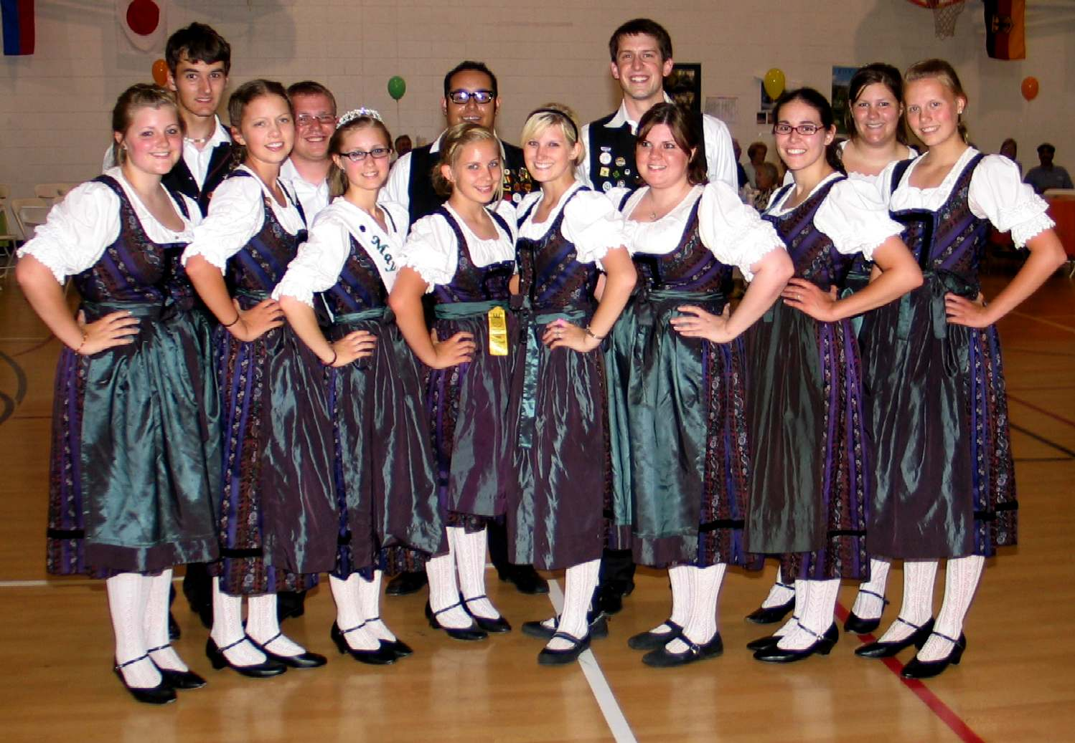
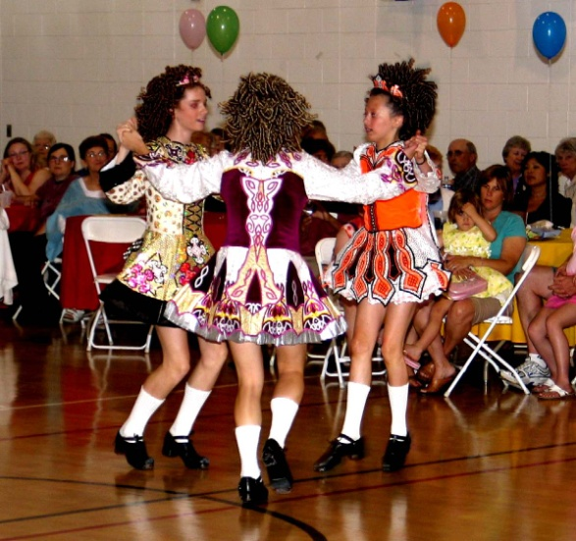
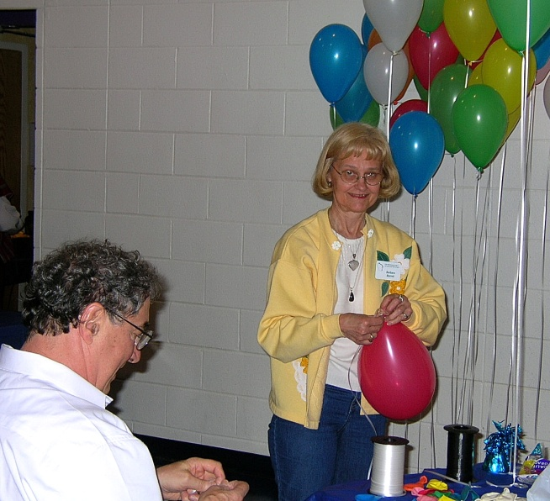
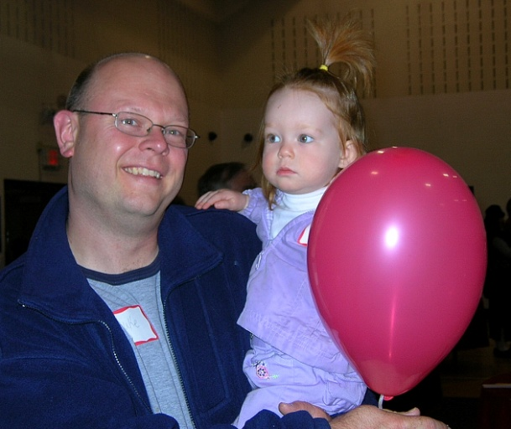
Milwaukee World Friendship Day

Slide 30
Event held at La Casa Esperanza and now an ongoing relationship has been developed with the Hispanic center
Ethnic dance groups performed
100-150 diverse people from the community attended
Raised around $4000 to go towards our annual contribution to the Legacy Fund and to our club activities
Promoted by the media
Required a year of planning

Slide 31
Groups FFI is Working With
OLLI (Osher Lifelong Learning Institute)
EF (Education First)
National Peace Corps Association
SERVAS

