Slide 1
Using a Retreat to Establish Club Goals
Friendship Force of Northern Illinois

Slide 2
Requirements for a Successful Retreat
Location — get away from the routine
Good working conditions
Without interruption
Comfortable space for a group
Opportunities for Play!
Simplified food (cater or make ahead)
A clear agenda and goals

Slide 3
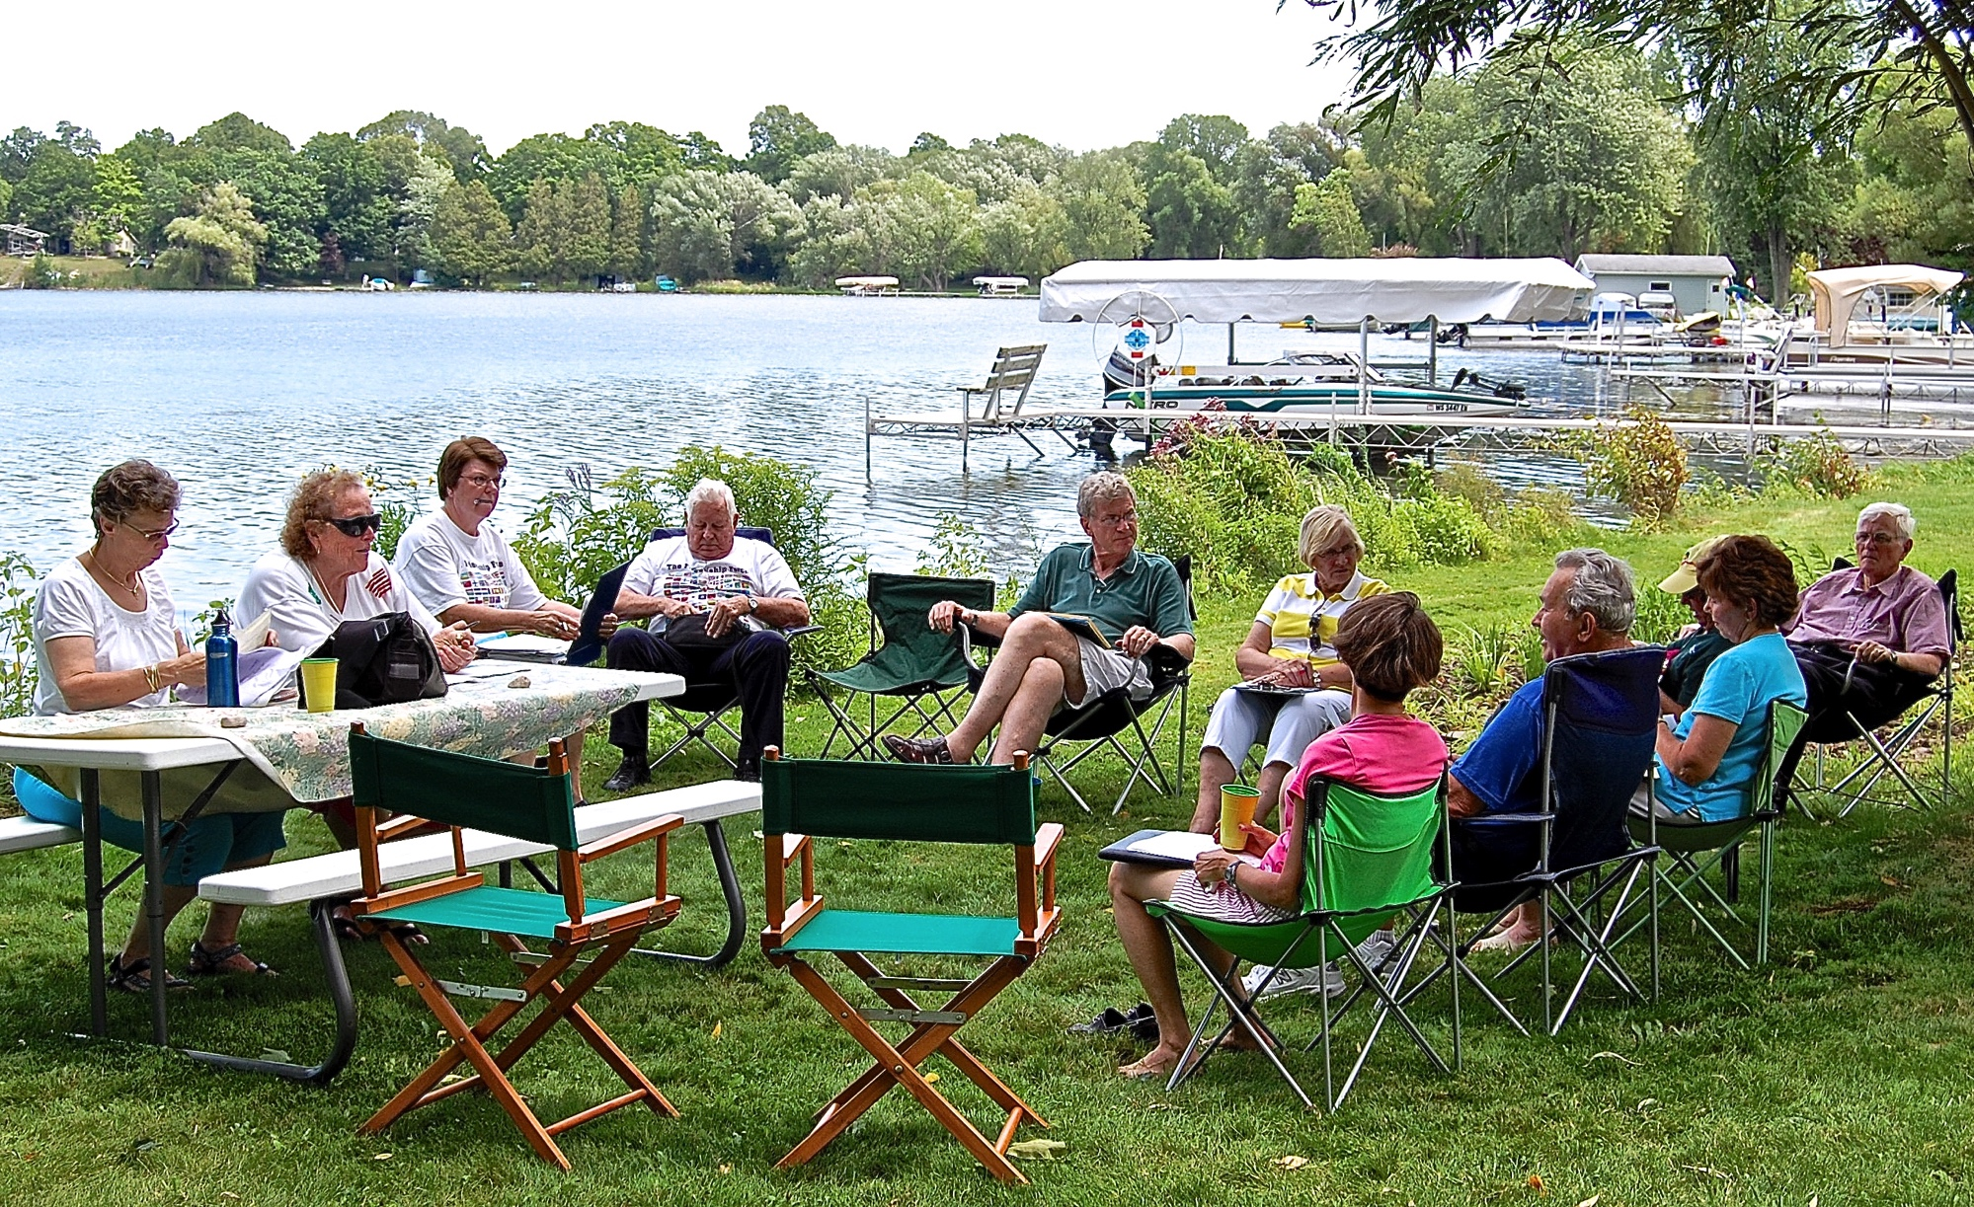
Northern Illinois Board Retreat
at a member’s Wisconsin cottage, 2009

Slide 4
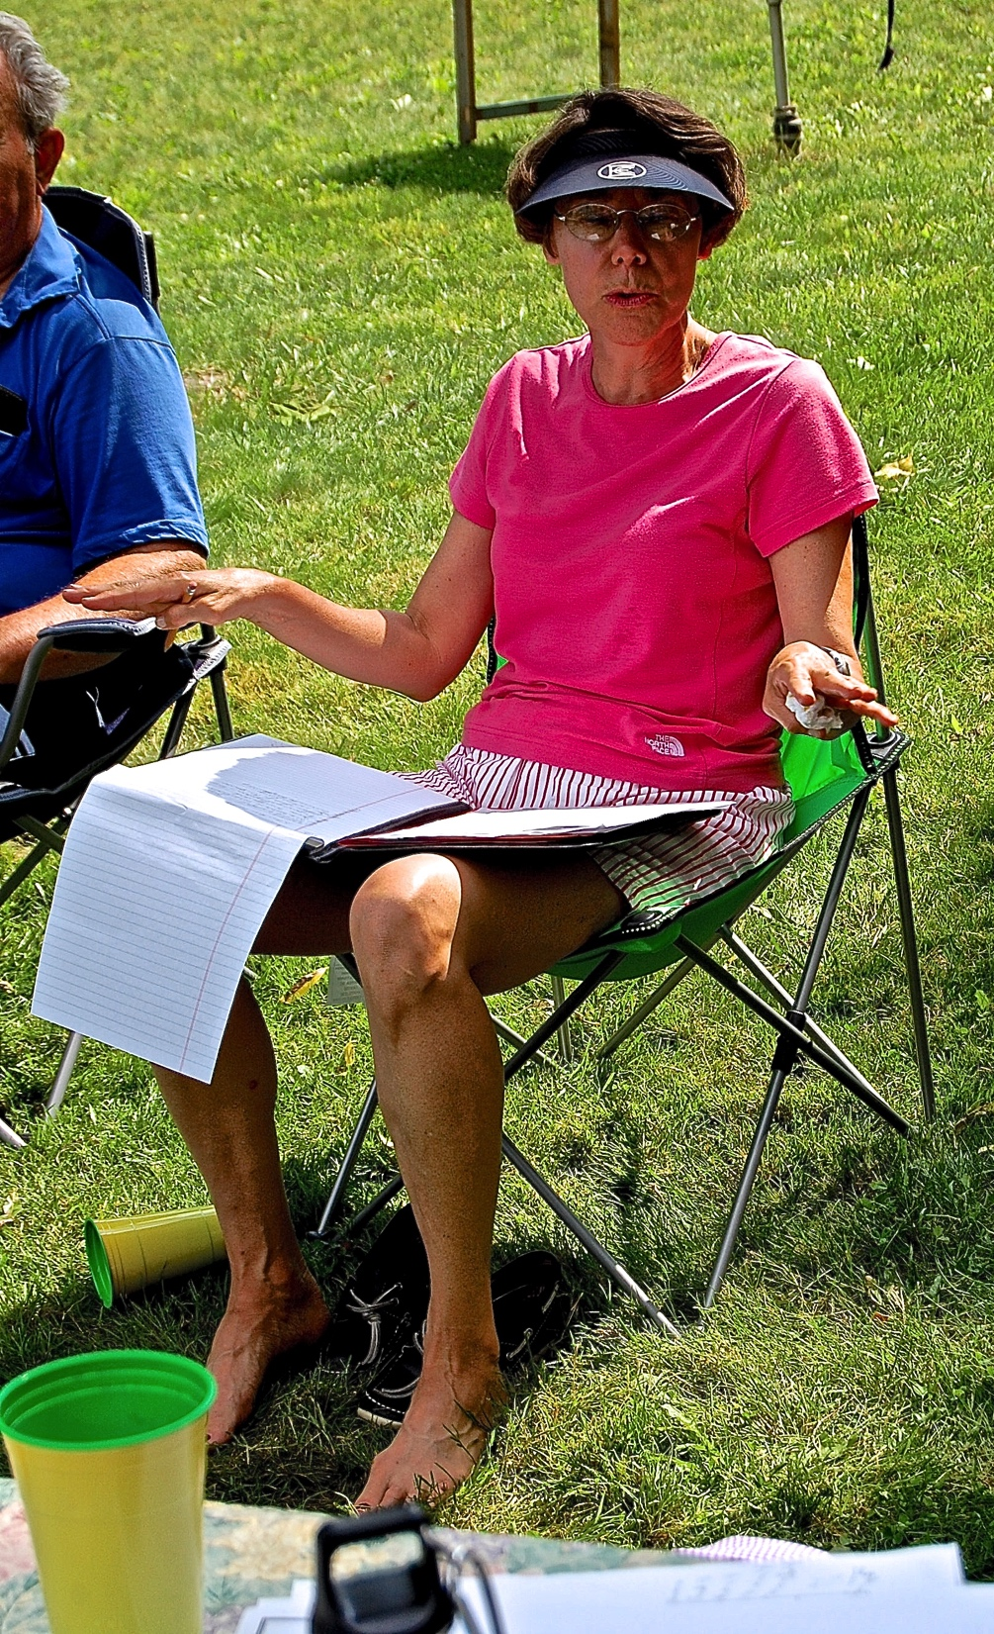
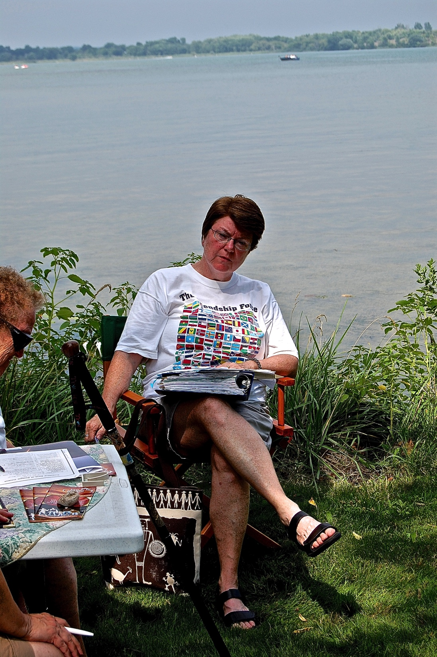
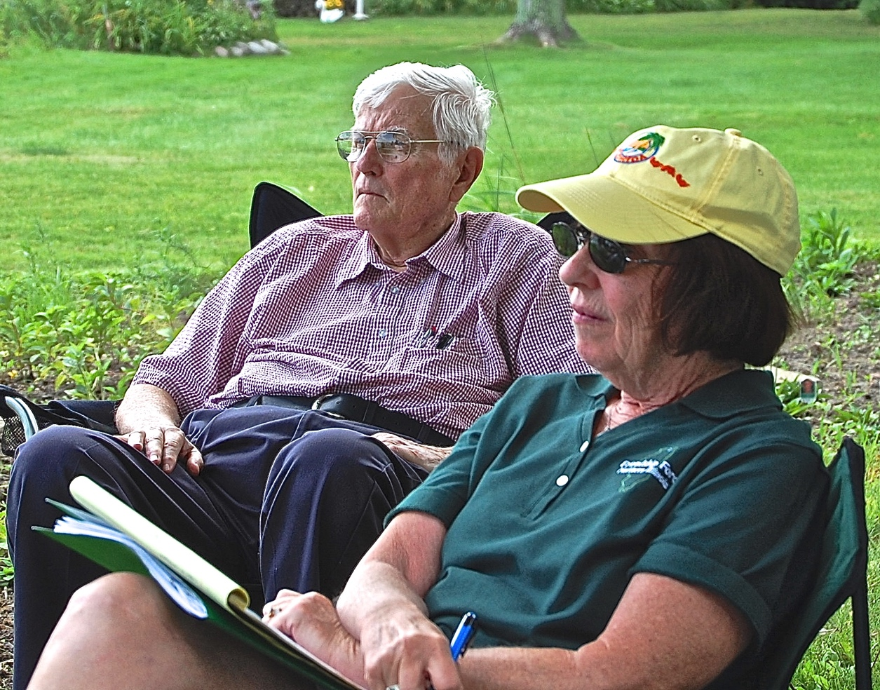
We Worked

Slide 5
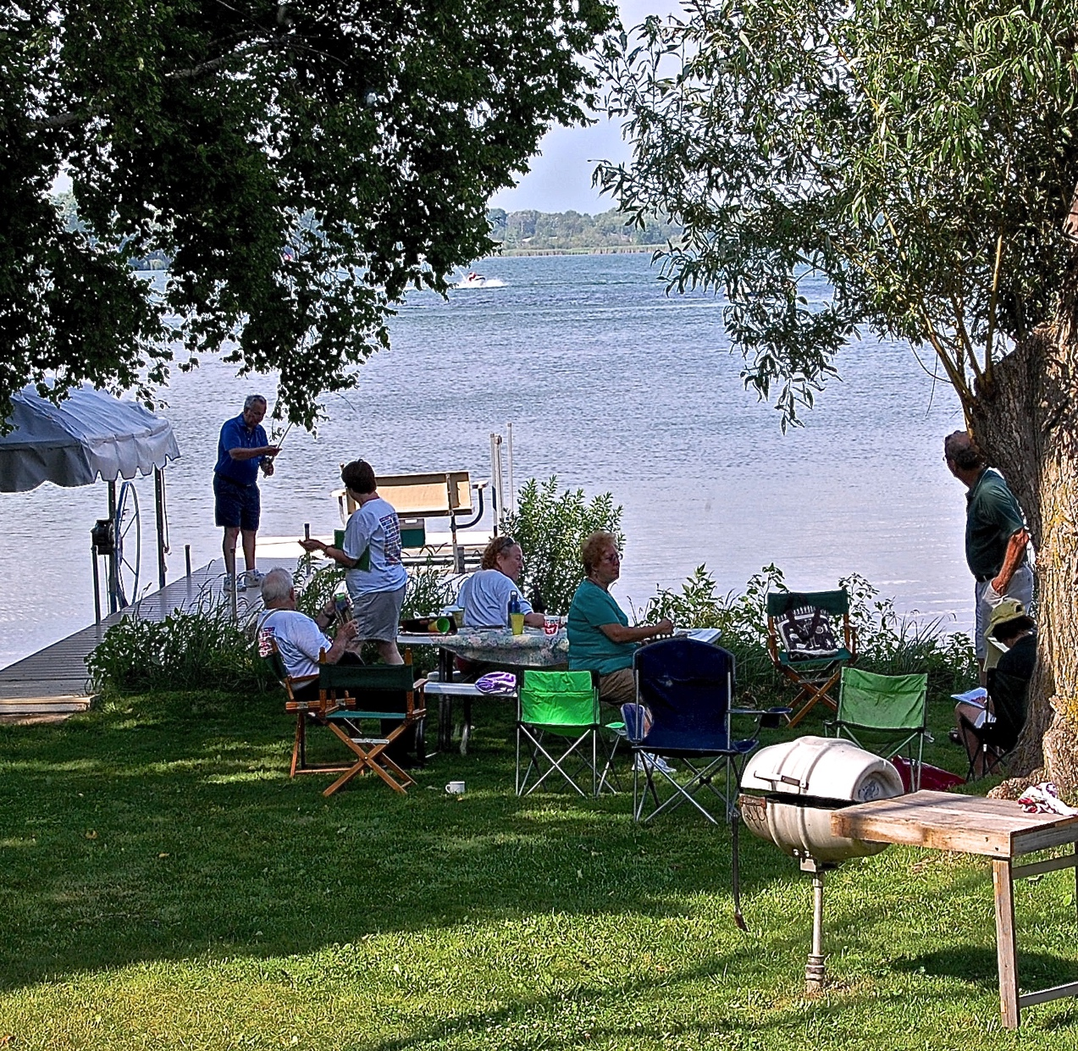
We Played

Slide 6
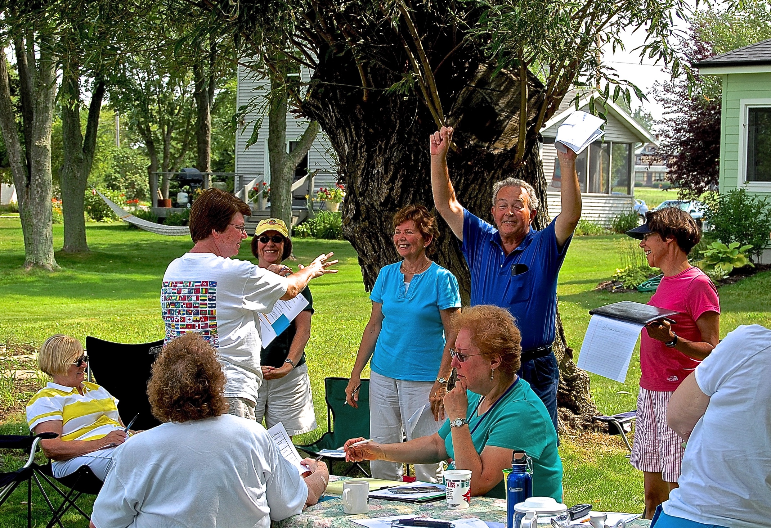
And we met our goals!

Slide 7
Essential: ALL Board Members attend.
Also: Invite new, younger members
not yet on the Board.

Slide 8
Include team building activities
before beginning club business.
For example:

Slide 9
Numerous Team Building Activities can be found on the internet.

Slide 10
President’s Vision
(an example)
Friendship Force will be known in our community as an organization that reaches out to the local ‘international community,’ seeking to make them feel welcome while helping them to understand the culture they have joined.

Slide 11
Participants
Discuss and Refine
this Vision as needed.
Participation = Teamwork = Buy-in

Slide 12
Leadership TEAM
develops club GOALS
out of the vision.
Participation = Teamwork = Buy-in

Slide 13
Club Goals
(an example from FFNI, 2009)
Increase membership by at least 10%;
Stay connected to current club members;
Become involved in a service project;
Know, understand, and embrace cultures and individuals different from ourselves; and
Be an active force for peace and friendship in our community and the world.

Slide 14
Leadership TEAM
develops and commits to means of achieving goals.
Participation = Teamwork = Buy-in

Slide 15
Leaders’ Commitment to Goals
(an example from FFNI, 2009)
How YOU will help us meet our goals:
Who are three perspective members we should contact or you will bring to a meeting?
What more can we do to insure we connect with all club members throughout our large geographic area?
What are ideas for active community involvement to further Friendship Force values?
What cultures should we explore in our programs?
What have we not done or considered that would further the cause of peace?

Slide 16
The President does not act alone!

Slide 17
The President’s Role:

Slide 18
Encourage & Support the Leadership Team
as they work with the whole membership to fulfill the goals.

Slide 19
Monitor Progress
On the agenda of every Board Meeting
Done by whole Leadership Team
Adjust Goals as needed

Slide 20
Communication
Responsibility of Leadership Team, not just President
Keep Goals in front of the members via
— Newsletters
— General meetings
— Occasional emails to the members
— Texts, tweets, etc.

Slide 21
Additional Ideas on Meeting Goals
Consult each other
Email or call other regional presidents
Email or call your FF Regional Rep
Email or call Staff at FFI in Atlanta!
Use the forms and other resources available on the FFI Website

Slide 22
Other Considerations
Discover & use the talents of your membership
Younger members will be accustomed to collaborating in teams
Develop & implement a working plan to engage new members

Slide 23
Collaboration Mentors New Leaders as they
Set goals together
Create strategies to fulfill those goals together
Implement those strategies together
Evaluate and revise goals together
Learn collaborative leadership together

