Slide 1
Best Practices

Slide 2
Membership
Nara, Japan has created the category of Associate Member with a reduced fee for families in their 30s and 40s who aren’t ready to participate in many club activities
Hiro Onishi (holinonenara@kcn.jp)

Slide 4
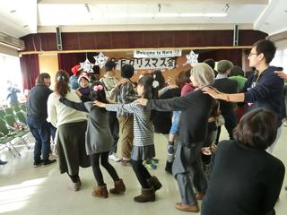

Slide 5
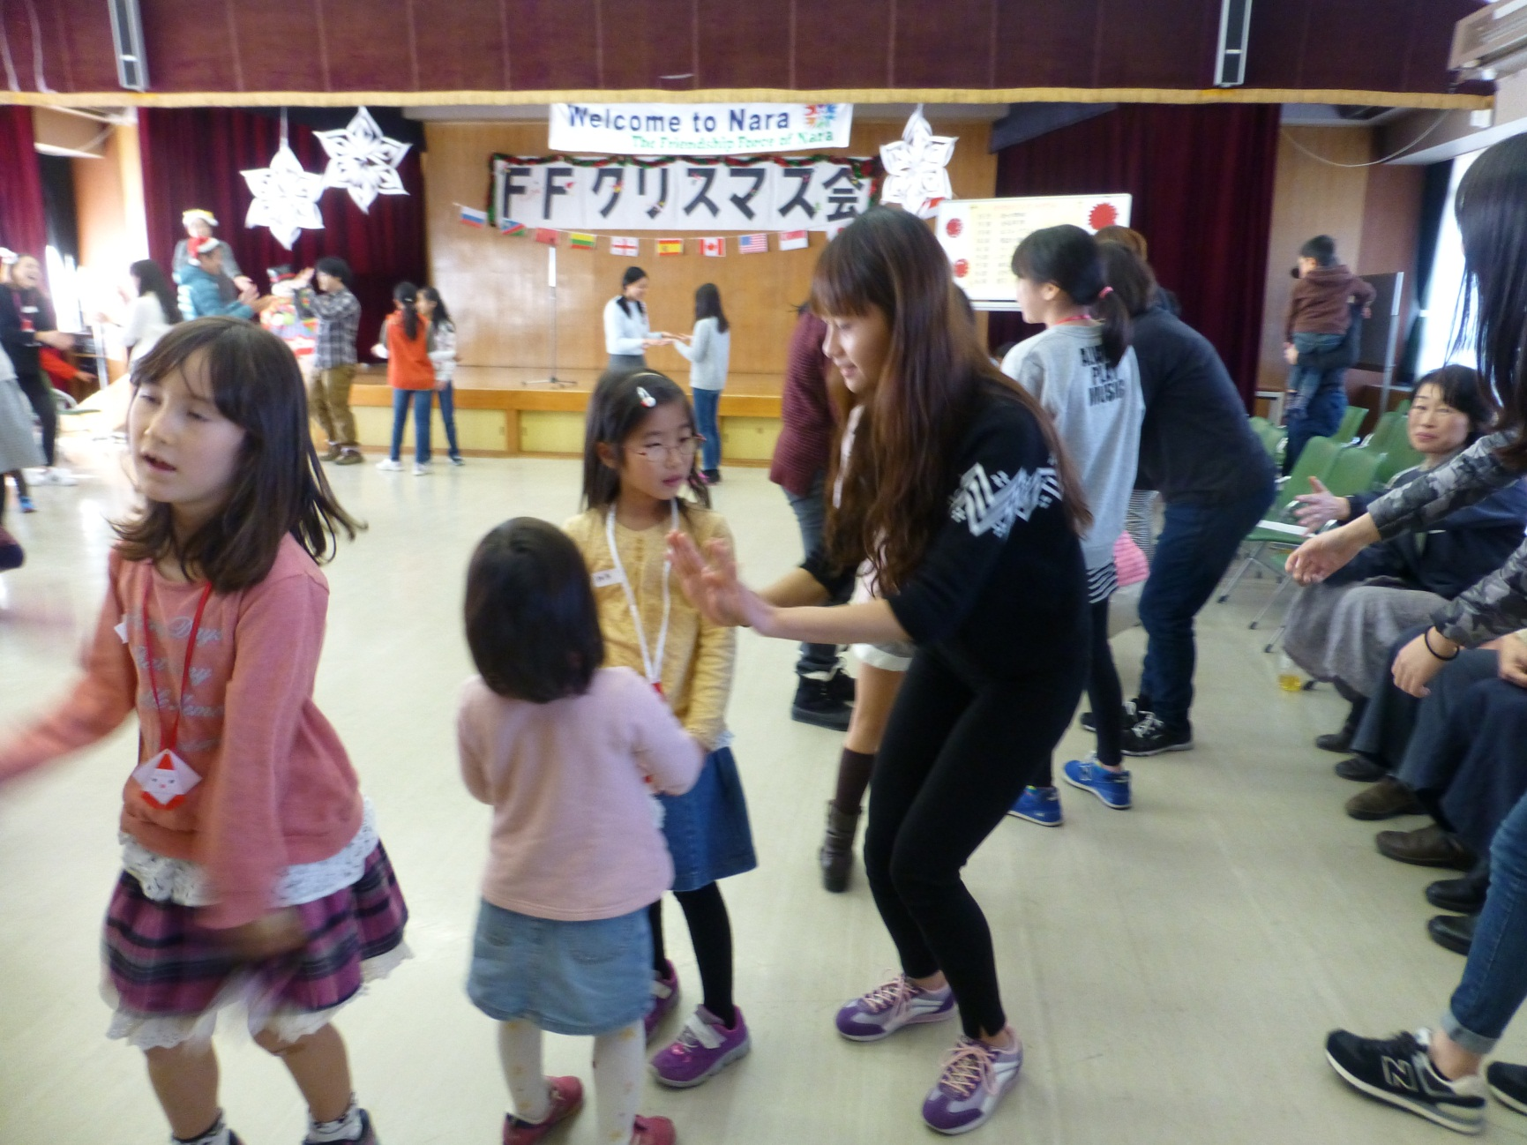

Slide 6
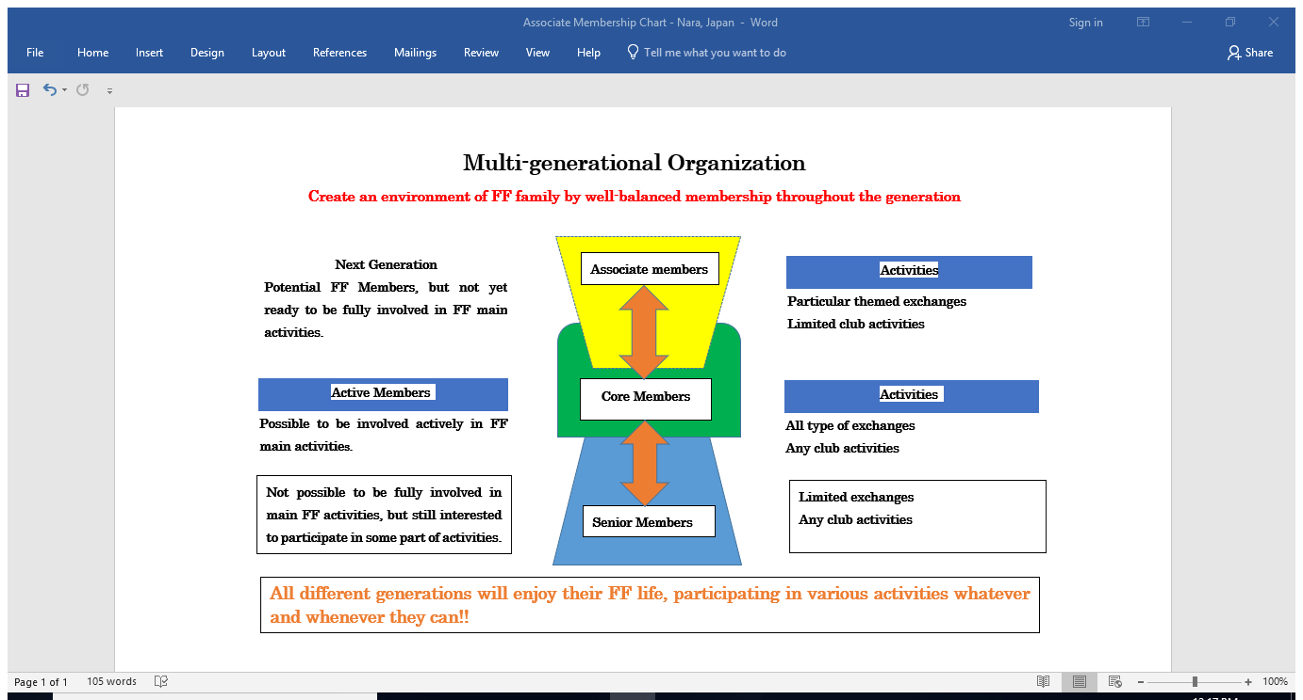

Slide 7
Membership
Izmir, Turkey has 3 generations actively involved in club
Dilek Sinlak (sinlakdilek@yahoo.com)
Olympia, WA had an event with Rick Steves. 600 people attended. 90-100 new members.
Gwen Harfst (gwenharfst@hotmail.com)

Slide 8
Social
Eastern Washington/Northern Idaho quickly grew to 100 members by having a monthly social activity (eat out) at different times (breakfast, lunch, dinner)
Del Liljegren (delwfs@hotmail.com)

Slide 9
Social
Ribeirao Preto, Brazil club, with mostly working members, hosts meetings in a pub or restaurant
Simone Lanzoni (simone@teseprime.org)

Slide 10
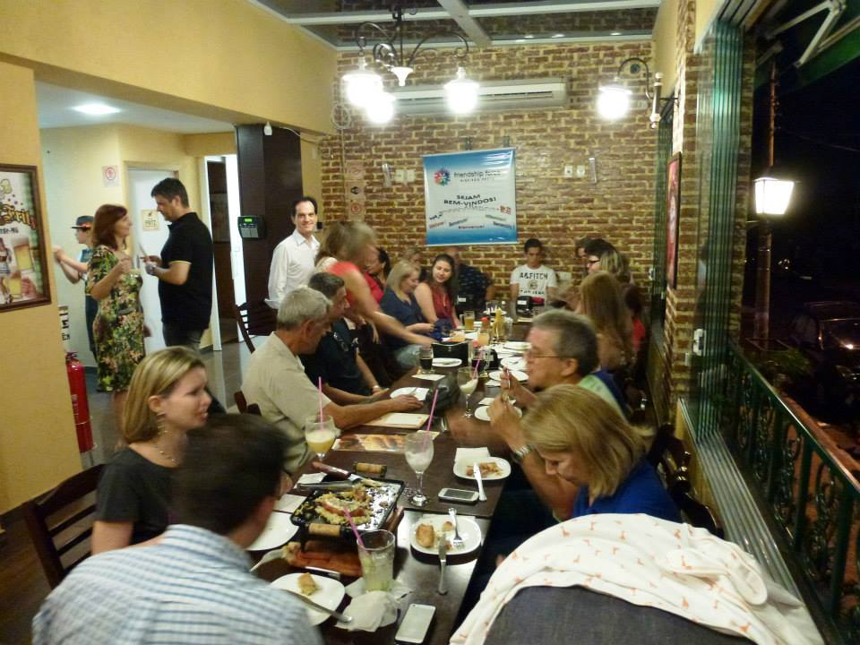
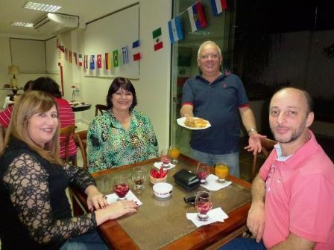
We used to have club meetings in a member’s home, with refreshments and biscuits.
Now, we meet at bars and restaurants, where people can have tea, beer, a glass of wine, or a sandwich on his/her expense.

Slide 11
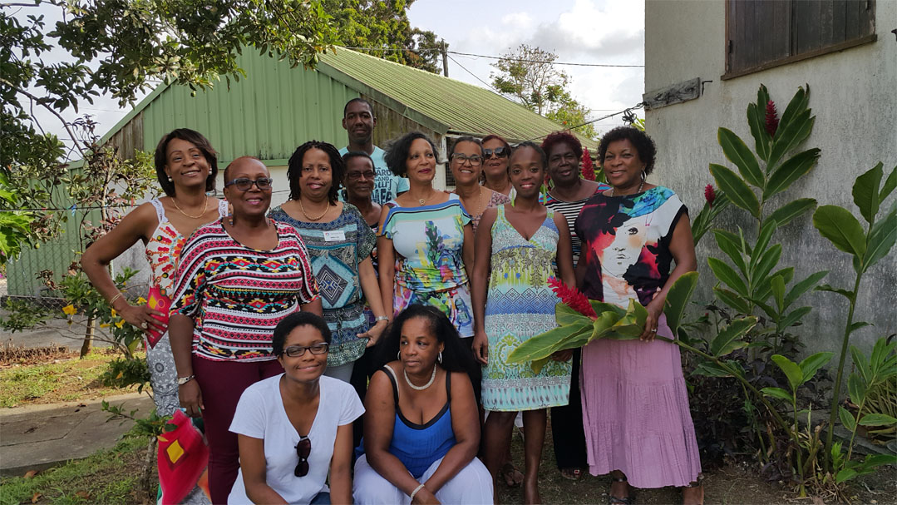
Social
Guadeloupe club includes families in club
activities (200 participants at farewell dinner
of first inbound journey)
Therese Vilovar (theresevilovar@msn.com)

Slide 12
Activities for Inbound Programs
Baton Rouge had a “Pick Your Passion” program providing options for the ambassadors
Bob Duncan (mardigrasbob@hotmail.com)
Solothurn, Switzerland may plan an under 30 program for ambassadors from Germany
Serafina Haefeli (serafina.ffi@gmail.com)

